Slide 1
Inquiries Received by the Authority of People with Disability through the “Contact Us” System
Fourth Quarter of 2024

Slide 2
Introduction:
Governance of inquiries received by the Authority of People with Disability (APD) via the “Contact Us” system, with the aim of raising awareness, ensuring access to rights, and addressing the challenges faced by people with disabilities.

Slide 3
Summary of Inquiries Received via the "Contact Us" System in 2024
Total | Active inquiries | Closed inquiries | Year
923 | 4 | 919 | Inquiries for 2024

Slide 4
Detailed Summary of the Fourth Quarter of 2024 Activities

Slide 5
Summary of October 2024 Activities
# | Review of Inquiries
0 | Active inquiries
66 | Closed inquiries
66 | Cumulative total
Public Relations
Research and Studies
Private and Non- profit Sectors
Government Sector
Data Management Office
National Registry
Legal Affairs
Partnerships Management

Slide 6
Summary of November 2024 Activities
# | Review of Inquiries
0 | Active inquiries
40 | Closed inquiries
40 | Cumulative total
Data Management Office
National Registry
Public Relations
Private and Non- profit Sectors
Partnerships Management

Slide 7
Summary of December 2024 Activities
# | Review of Inquiries
4 | Active inquiries
49 | Closed inquiries
53 | Cumulative total
Data Management Office
Legal Affairs
Private and Non- profit Sectors
Government Sector
Partnerships Management

Slide 8
Overdue Active Inquiries (2024)
Active Inquiry | Number | Status
Regulations Department | 1 | No action taken
Government Sector | 3 | Under review by the relevant department

Slide 9
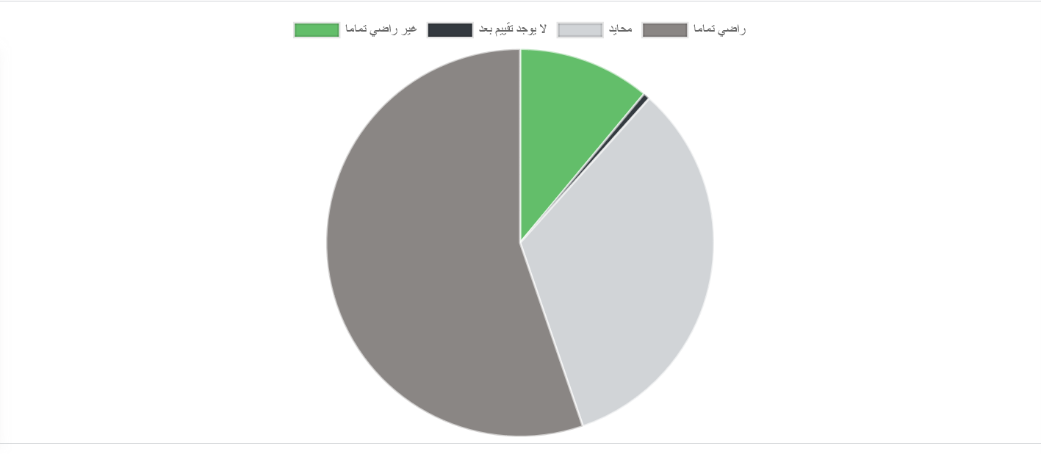
Customer Ratings

Slide 10
Thank you
Partnerships Planning and Development Department
Partnerships@apd.gov.sa

